Slide 1

Fatcat – automatic pet feeder
Presenters: Tal Bogen Danny Medan

Slide 2
Project in three parts
Hardware
Application
Server

Slide 3
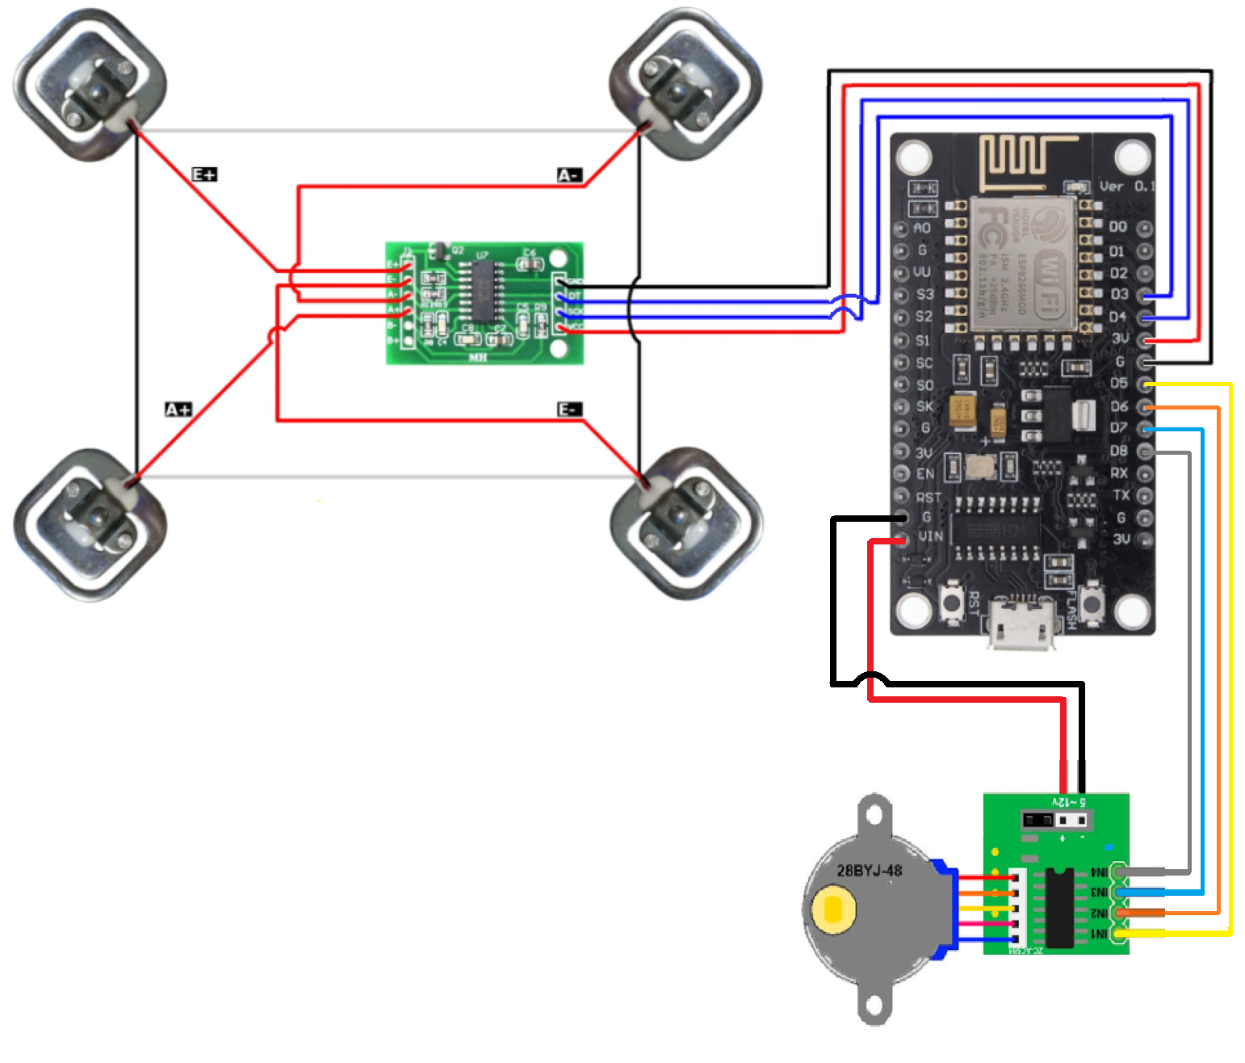
The hardware section oversees the real-life aspects of weighing and controlling access to the food bowl. It consists of:
NodeMCU controller
HX711 Analog/Digital converter
4X 50kg load cells
ULN2003 Stepper Motor Driver
28BYJ-48 Stepper Motor
Hardware
Components

Slide 4
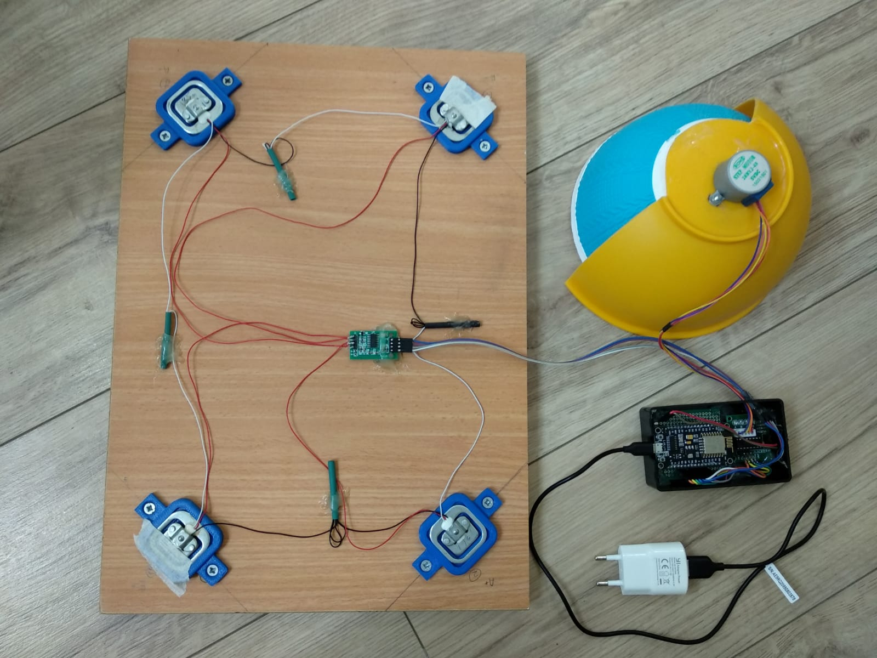
We implemented the scale and locking mechanism using:
Wooden board
4X 3D printed weight cell bases
2 half-bowls
The hardware system is powered by the NodeMCU’s Micro-USB port.
Hardware
Mechanisms

Slide 5
The Arduino code is a subset of C++ with two major functions:
setup() – which runs once when the board is turned on.
loop() – which runs continuously while the board is on.
As the name suggests, we used the setup() function to set up the sensors, drivers and WiFi settings. The loop() function is used to handle weighing, locking and communicating with the server.
Setup()
Loop()
Hardware
Arduino Code

Slide 6

The Arduino code communicates with the server using REST API calls.
The main communication is an update request every ~5 second intervals. This update also includes server requests flags. Once these flags are received the Arduino code will send its response accordingly.
The requests are:
Update
Send Current Weight
Post Log
Hardware
Communication

Slide 7
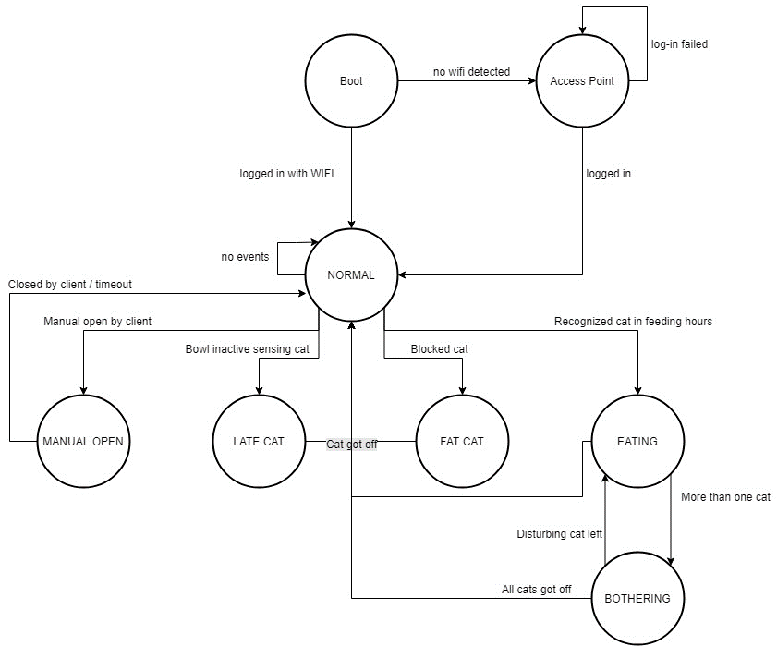
The running Arduino algorithm consists of 6 states:
Normal
Eating
Bothering
Fat Cat
Late Cat
Manual Open
Hardware
States

Slide 8
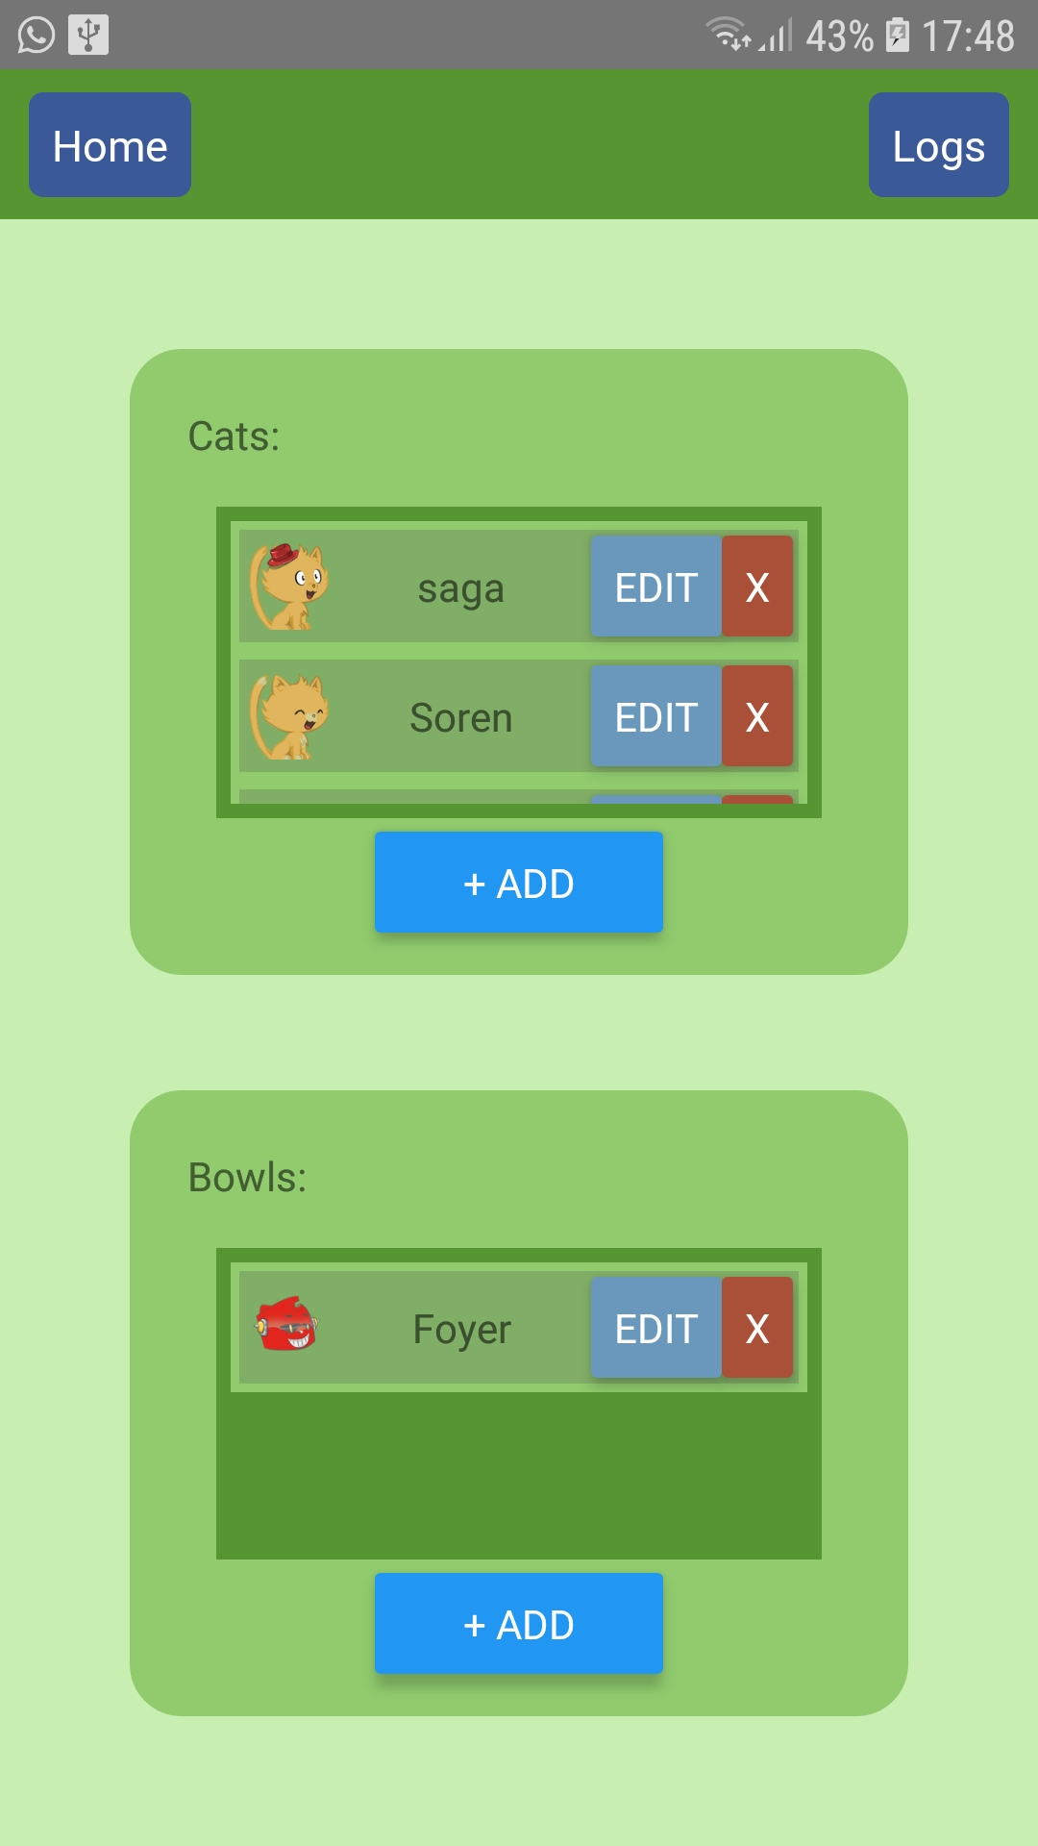

The Application “fAtcAt” is written in React Native, which enabled us to write an application that works on both Android and IOS phones.
The code is divided into the following subsets:
App.js
Pages
Services
Components
Application
React Native

Slide 9


The App communicates with the Server using both REST API calls and the socket.io library.
REST API is used for communication issued by the user, while the socket.io is used when the server issues the communication.
Application
Communication

Slide 10
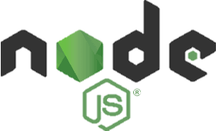
The server was written using NodeJs, a JavaScript based runtime environment that can execute code outside of web browsers.
It resides in the free cloud platform Heroku, which is linked with the project’s Git directory.
The code is divided into the following subsets:
Index.js
Controllers
Services
Models
Server
General Information

Slide 11
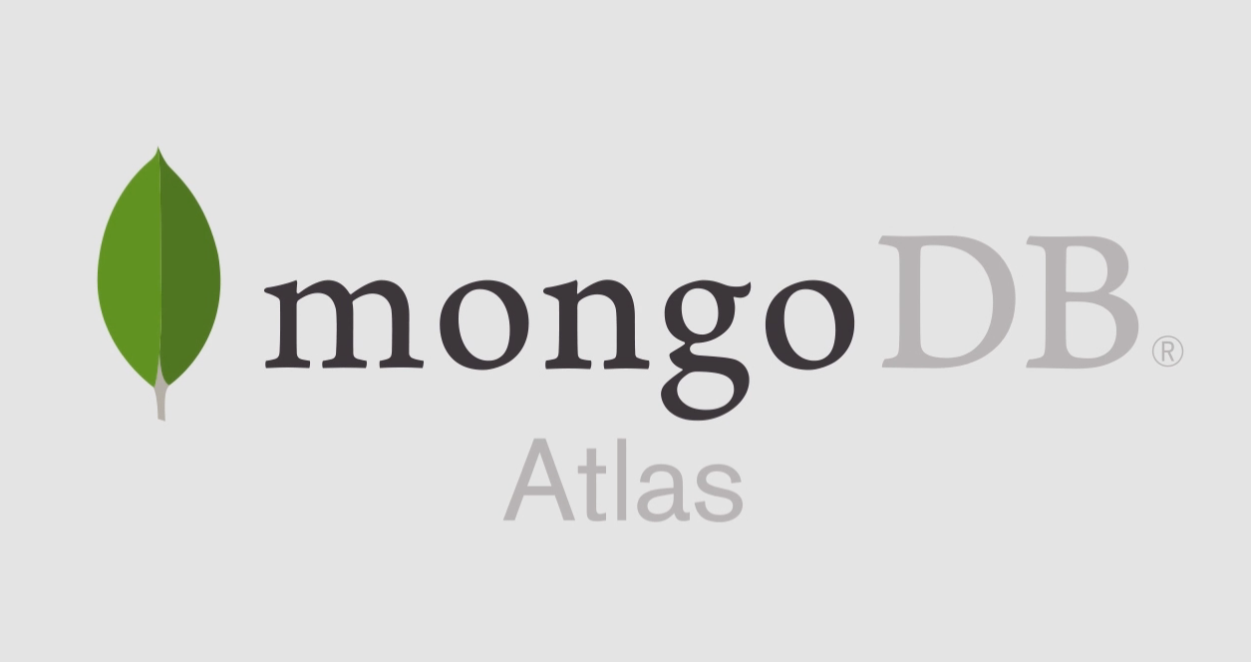
To store the database we used the MongoDB Atlas platform, which enables global access to the data.
The database contains these collections:
Bowls
Cats
Devices
With each collection containing documents of their type.
Server
Database
Notes:
בחרנו לא-ראלציוני למרות שאנחנו מכירים ראלציוני כי זה יותר תואם לשירותי ווב ומובייל

Slide 12
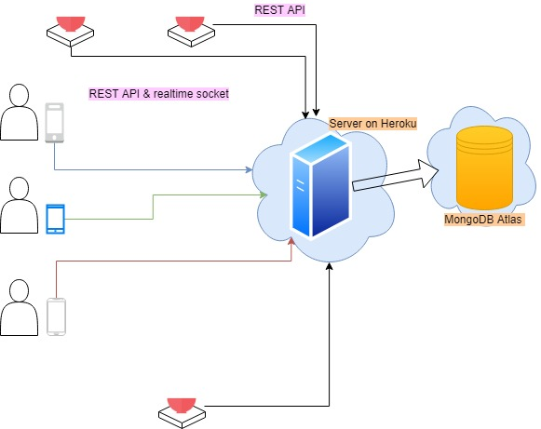
The Server bridges between the App, Arduino program and the database.
For standard client requests (i.e. Arduino updates, App value editing etc.) the server uses REST API.
In order to get the current weight on the Arduino sensor, the server uses a combination of REST API (to/from the Arduino) and socket.io (to the App).
Server
Communication

Slide 13

Thank You
Danny Medan
Tal Bogen

